Slide 1

Films Recommendation Expert System
S.M.U.H Senanayake

Slide 2

Table of Contents
Introduction
Problem
Solution and Why
Demonstration
Conclusion
Limitations
Future Enhancements
End

Slide 3
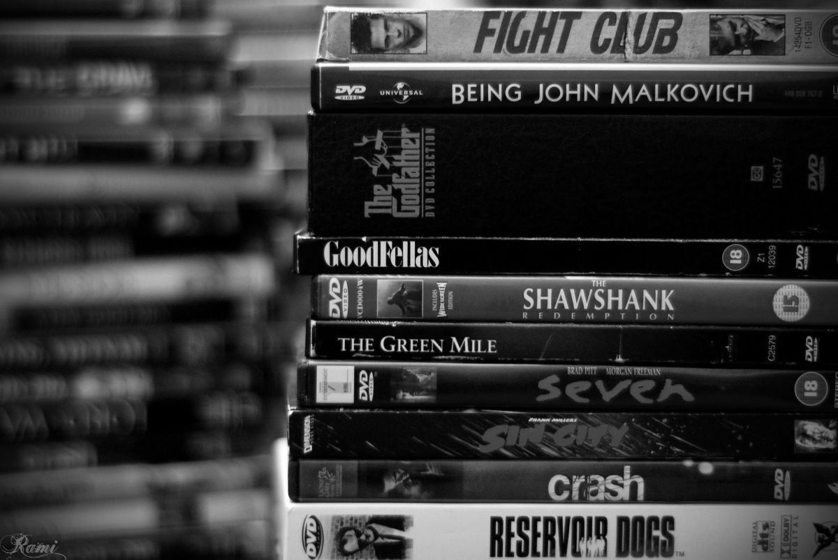

Introduction
Welcome to the future of movie recommendations!
we find a powerful solution that will revamp your video shop
A movie recommendation expert system is a computer program that can recommend movies to users based on their preferences.
Use to knowledge base of movies and user preferences to make recommendations.

Slide 4
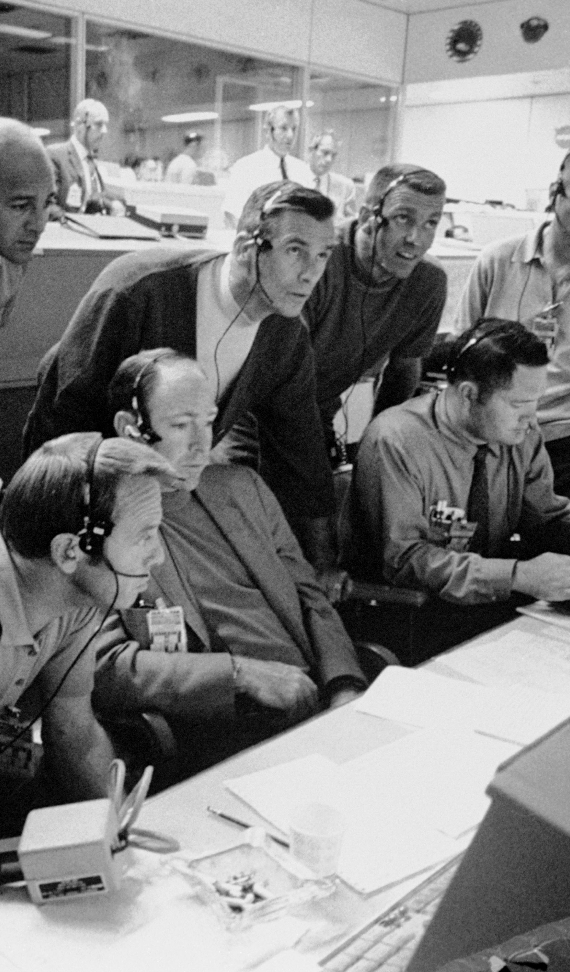
Problem
customers often struggle to find films that truly resonate with their tastes .
Video shops have a large inventory of movies, and it can be difficult for customers to find the movies that they want to watch.
Taking a long time to choose a film when the customer comes to the store.
How can we elevate the customer experience and boost revenue?

Slide 5

Solution and Why
Introducing the Movie Recommendation Expert System!
A movie recommendation expert system can help video shops improve their customer satisfaction and increase their sales
It can also help to reduce the amount of time that customers spend browsing the aisles of the video shop, looking for movies to watch.
Why it matters?
Enhanced Customer Experience - Customers discover movies perfectly suited to their preferences
Revenue Boost - Satisfied customers buy more, become loyal patrons, and drive revenue growth

Slide 6
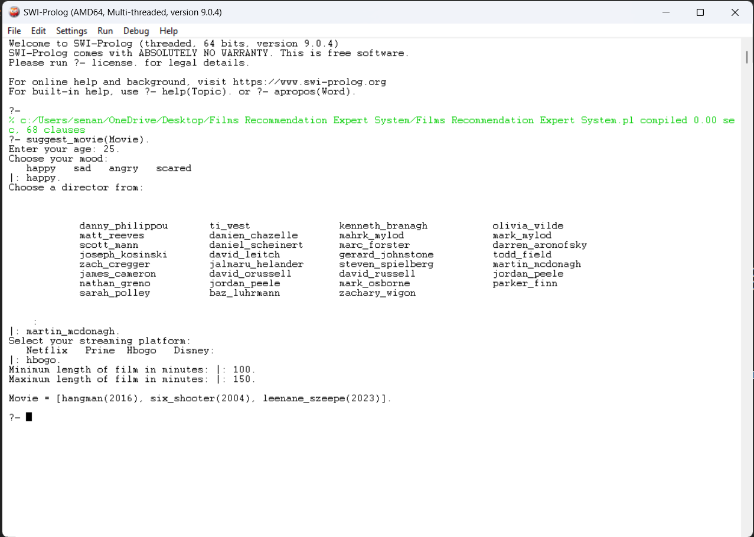
Demonstration

Slide 7

Conclusion
Our Movie Recommendation Expert System is poised to revolutionize your video shop experience
We've conquered the challenge of personalized movie selection
A movie recommendation expert system can be a valuable tool for video shops.
It can help customers to find movies that they are likely to enjoy,
it can help video shops improve their customer satisfaction and increase their sales.

Slide 8

Limitations
Data Dependency- Initial recommendations depend on user data; new users may not receive accurate suggestions
Content Availability- Recommendations are constrained by the movies available in your inventory
If the data is incomplete or inaccurate, then the recommendations will also be incomplete or inaccurate.

Slide 9
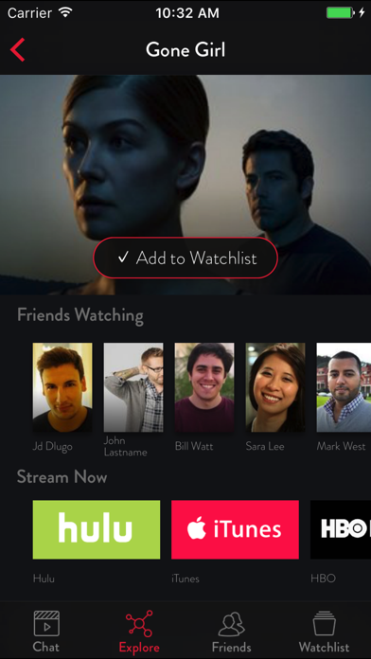
Future Enhancements
Integration with Streaming Services: Expand the system to include streaming platforms, broadening the range of recommendations
Advanced User Profiles: Incorporate more diverse user data sources for even more precise suggestions
Mobile App Development: Create a mobile app for on-the-go movie recommendations
This Photo by Unknown Author is licensed under CC BY-NC
This Photo by Unknown Author is licensed under CC BY-NC

Slide 10


